Slide 1
Local Government Reorganisation and Devolution ​ Town and Parish Council and Parish Meeting Working Group meeting​ (3) ​ 20 October 2025

Slide 2
Purpose​
To update on action points from the last meeting
To update on key workstreams.
Opportunity for further discussion.
Agenda
Welcome and introductions.
Update on Local Government Reorganisation (LGR) and Devolution, and timelines.
Update on decisions of Full Council on 14th October 2025
Town and Parish Council and Parish Meeting survey results.
Update on local devolution thinking.
Open discussion.
Any Other Business.
Close.

Slide 3
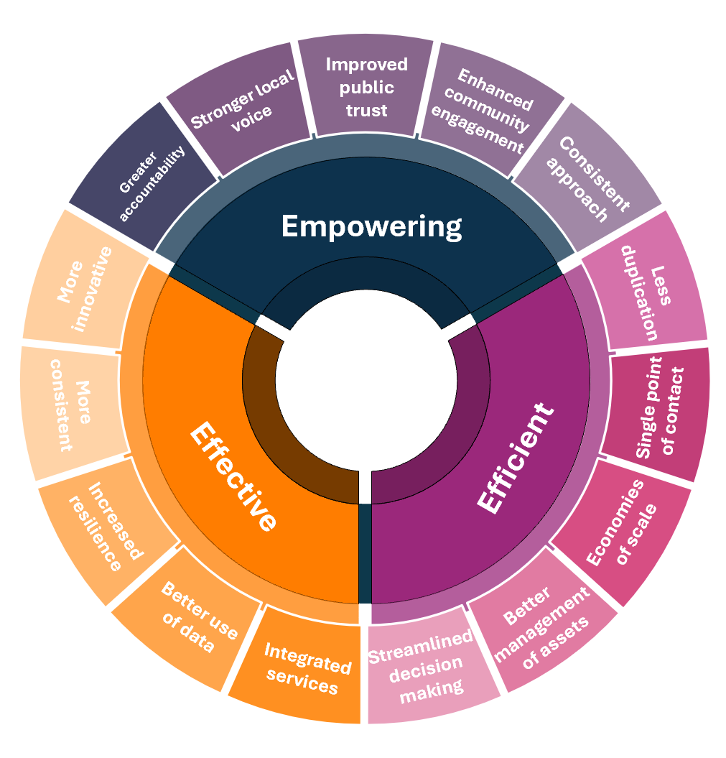
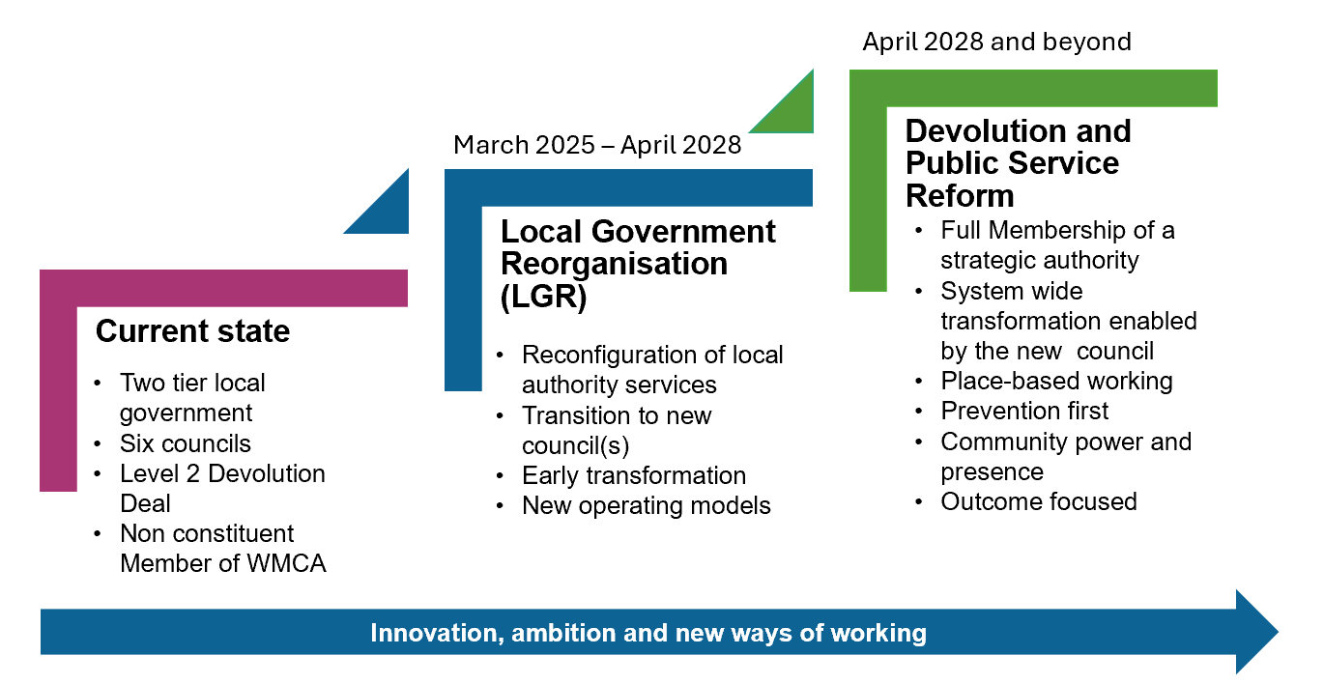
New ways of working

Slide 4
Timeline
English Devolution White Paper published on 16 December 2024
Formal invitation to submit interim plans received on 5 February 2025
Interim plans submitted by Councils on 21 March 2025
Feedback on interim plans sent to Councils on 3 June 2025
Full proposals for reorganisation to be submitted by 28 November 2025.
Government decision on the model of unitary Local Government for Warwickshire, likely Summer 2026 following consultation
Full proposals for reorganisation to be submitted by 28 November 2025.

Slide 5
WCC Full Council meeting 14 October 2025
Full Council agreed the following motions:
The Council recognises the importance of Town and Parish Councils, supports the establishment of such councils where they do not currently exist (e.g., Nuneaton, Rugby, Bedworth, and Bulkington), and endorses the role of Town and Parish Councils as a necessary means of preserving local identity along with the devolution of roles and powers to such councils where there is an appetite to do so.
The Council accepts that full constituent membership of the West Midlands Combined Authority would be the best arrangement for any new unitary authority or authorities in Warwickshire to meet the Government’s requirement of full devolution.
The Council supports the proposal of a single unitary council for Warwickshire as the optimum model of local governance.

Slide 6
Town and Parish Council Survey
An online survey to seek a clearer understanding of the views of Town and Parish Councils and Parish Meetings on LGR and Devolution took place over September.
The findings help all stakeholders to understand the needs, opportunities, and challenges faced by Town and Parish Councils and Parish Meetings in relation to proposed changes.
The findings support further conversations with, and between, Town and Parish Councils and Parish Meetings.
The invitation to complete the survey was sent to all Town and Parish Councils, and where contact details were available, to Parish Meetings.
A total of fifty-five responses were obtained. Fifty responses were submitted on behalf of a Town or Parish Council or Parish Meeting, and five responses provided views from individuals.

Slide 7
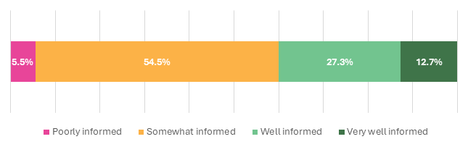
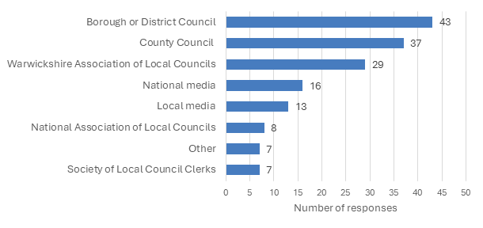
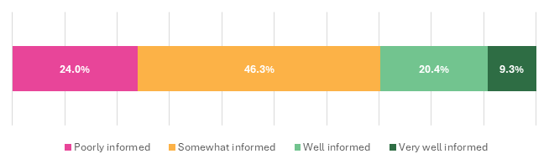
Survey results - Perceived understanding of LGR and Devolution
Figure 1: Percentage responses to “How well informed do you feel
about matters relating to Local Government Reorganisation?
Figure 3: Number of responses to “Which sources of information have informed your understanding regarding Local Government Reorganisation and Devolution?
Figure 2: Percentage responses to “How well informed do you feel
about matters relating to Devolution?”
Notes:
Table 2 shows the themes of responses to the following question “are there any other information sharing avenues you would like us to explore”. Twenty-two (40.7%) respondents answered this question. Overall, 40.9% (n=9) provided a comment related to the theme “direct contact with parish councils” and 18.2% (n=4) provided a comment related to “more information needed”.

Slide 8
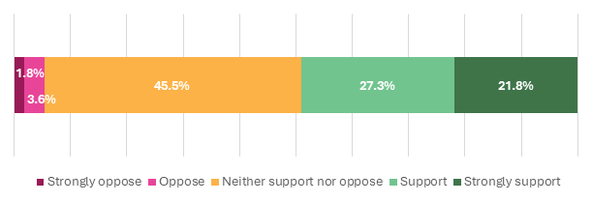
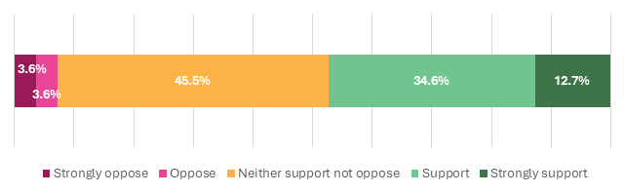
Survey results - Local Governance Structures
Figure 5: A consideration of (re)introducing Area Committees with delegated powers, and possibly budgets
Figure 6: Percentage of responses to “Would your Council/Meeting support the introduction of local Community Boards or Networks”
Figure 5 shows that half of respondents, 49.1% (n=27) strongly support or support the re-introduction of Area Committees, 45.5% (n=25) would neither support nor oppose and 5.4% (n=3) would strongly oppose or oppose.
Respondents were asked if they would support the introduction of local community boards or networks. A total of 47.3% (n=26) would strongly support or support local community boards or networks, 45.5% (n=25) would neither support nor oppose and 7.2% (n=4) would strongly oppose or oppose.
Notes:
Feedback on Area Committees: Almost half 48.6% (n=18) provided a comment relating to needing more information; 24.3% (n=9) provided a comment relating to importance of local representation; and 18.9% (n=7) provided a comment relating to Areas Committees needing to have a clear purpose and governance
Feedback on Community Boards/Networks: Respondents were asked to expand on their thinking regarding the introduction of local community boards or networks. Comments were received from 61.8% (n=34) of respondents, these have been themed and are shown in Table 5. Overall, of those who responded, 38.2% (n=14) made a comment relating to more information being required, 17.6% (n=6) made a comment relating to requiring a clear purpose and objectives, and 14.7% (n=5) provided comments advising of the benefit of ensuring there was local representation.

Slide 9
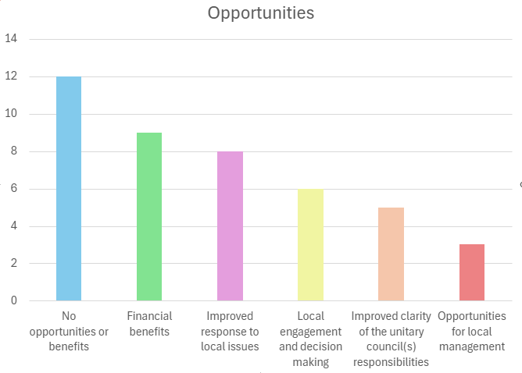
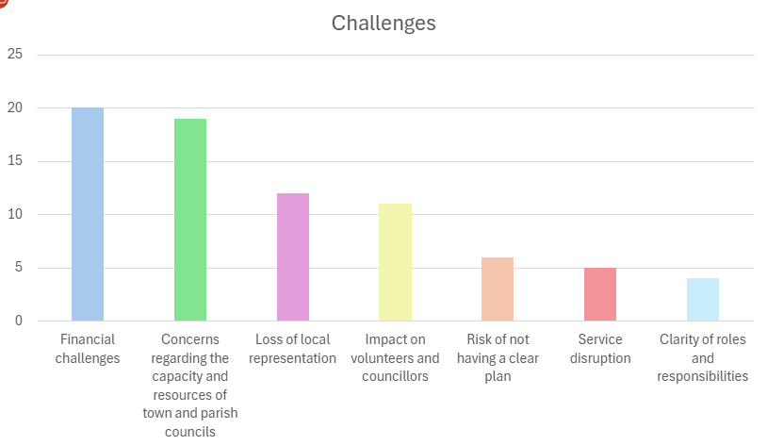
Survey results - Perceived opportunities and challenges associated with LGR and the potential devolution of services
3
6
12
6
9
8

Slide 10
Local devolution
Town and Parish Councils will have the opportunity to take on devolved assets and services. The approach will be flexible and collaborative; offering a list of services that Town and Parish Councils could take on, aligned with their capacity, appetite, and local priorities. ​
​
New Town and Parish Councils will be created in areas that do not currently have them, i.e., Bedworth, Bulkington, Nuneaton, and Rugby. ​
​
Principles of working with Town and Parish Councils could include:​
​
Building on strong foundations. The new unitary council will build on existing relationships and structures to foster collaboration and continuity. These relationships provide a trusted platform for engagement, enabling shared learning, co-design, and a consistent approach to local governance while recognising the important and distinct role that Town and Parish Councils play.
Flexibility. The flexible framework supports tailored arrangements that reflect the diversity of communities, empowering councils to shape their role in service delivery and local leadership.​
Community-centred. Town and Parish Councils will continue to play a key role in local democratic accountability, acting as visible and trusted leaders within their communities.​
Financial neutrality. Any devolution will be financially neutral, and, at the point of transfer, will ensure Town and Parish Councils are adequately resourced to undertake any additional functions and services. ​

Slide 11
Local devolution
At our last meeting, we shared examples of services that other Councils - following reorganisation - have identified as suitable for devolution to Town and Parish Councils. Building on your feedback, we’ve now carried out a filtering exercise to assess the relevance and feasibility of these services within the Warwickshire context.
The criteria used were:
Existing delivery. Are there examples of local Town and Parish Councils already delivering this type of service?
Statutory status. Is the service statutory or non-statutory?
Cost implications. Would splitting the service increase costs and reduce economies of scale?
Local appetite. Is there likely to be interest from Town and Parish Councils in taking on the service?
Asset implications. Would devolving the service require transferring ownership or leasing assets to Town and Parish Councils?

Slide 12
Local devolution
Following this assessment, a refined list of potential services for local devolution could include:
Play areas
Sports grounds
Parks and open spaces
Public toilets
Allotments
Community centres
Cemeteries and churchyards
Off-street carparking
Memorials
Minor highways functions
Meals on wheels
Community libraries
Community transport
Neighbourhood watch
Schemes to tackle loneliness and isolation
Community grants
Local environmental initiatives.
We welcome your thoughts on this list.

Slide 13
Discussion

Slide 14
Next steps
Review and process the feedback from today’s meeting.
Use feedback to inform the agenda and format for the meeting of the wider group of c220 parishes on 4 November.
Use feedback to inform final proposals where appropriate. Being considered by Cabinet 6th November 2025 for submission to Government by 28th November 2025
Arrange a further Working Group meeting for later in the year (we are keen to keep the conversation going with the smaller group and wider group beyond the submission date).

